Slide 1

Infosys Springboard Internship Program
EDA - US RoadSafe Analytics
Artificial Intelligence
Intern Team

Slide 2


AGENDA
Project Statement: The aim and overview of the accident severity analysis.
Project Objectives: Key aims and focus areas of the analysis.
Documentation: Analytical approach and dataset details.
ML Algorithms: Algorithms application and data-driven predictions.
Dashboard View and App Structure: Key features and interactive visualization.
Key Findings and Insights: Major insights and their implications.
Tech Stack Avery: Tools and technologies used together.
Future Scope: Suggestions for safety and research improvement.
Conclusion: Summary and final thoughts.

Slide 3
PROJECT STATEMENT
PROJECT OBJECTIVES
The primary goal of this project is to analyze a large dataset of road accidents to uncover trends, patterns, and key factors contributing to accident severity. The project involves performing in-depth exploratory data analysis (EDA) using Python libraries such as Pandas for data manipulation, Matplotlib and Seaborn for statistical visualization, and Streamlit for developing an interactive dashboard to extract meaningful insights that can help improve road safety across the United States.
Business Context:
Stakeholder presentations
Academic publication
Project portfolio
Grant proposals
Explore and understand real accident data from across the US.
Clean and prepare the data for accurate analysis.
Study how time, weather, and location affect accident severity.
Identify high-risk areas and major accident causes.
Build an interactive dashboard for easy data visualization.
Provide insights that can help improve road safety.

Slide 4




Documentation and ML Algorithms
Dataset Overview
ML Algorithms
Dataset Name : US Accidents (2016 - 2023)
Geographic Coverage : 49 states of the USA
Time Period : February 2016 to March 2023
Total Records : Approximately 7.7 million accident records
Source : Kaggle
DBSCAN stands for Density-Based Spatial Clustering of Applications with Noise.
It uses distance (ε) and minimum points (minPts) to find meaningful clusters.
Geospatial Analysis: Detects clusters of any shape.
In the US Accidents dataset, it spots accident hotspots and filters out rare cases.
DBSCAN
Dataset
Documentation
Machine Learning

Slide 5
DASHBOARD VIEW AND APP STRUCTURE

Slide 6
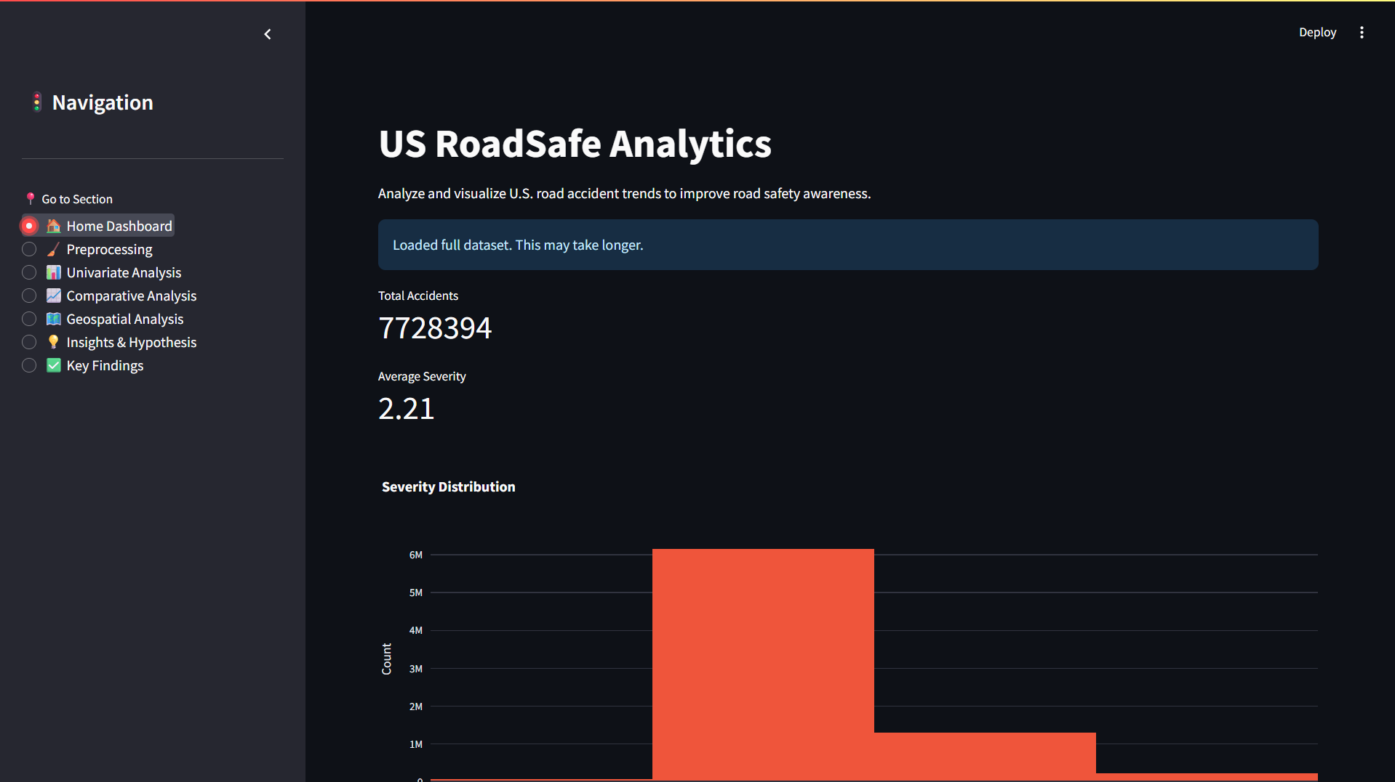
DASHBOARD 1

Slide 7
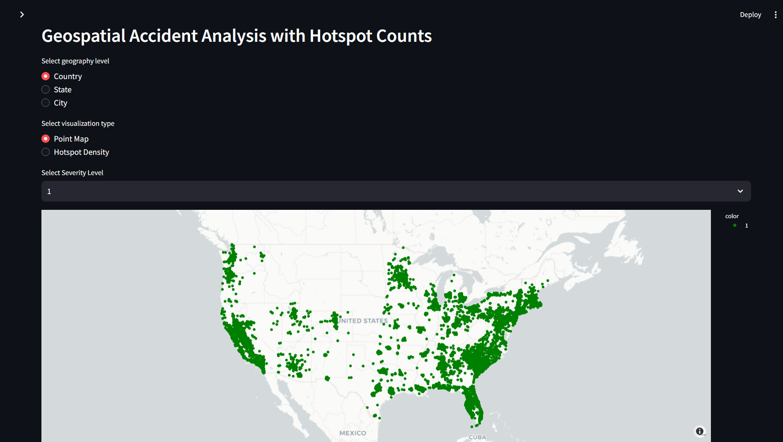
DASHBOARD 2
Geospatial Analysis shows distribution across locations such as (states and cities) and helps to understand regional variations in accident patterns.

Slide 8
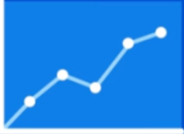

Key Findings and Insights

Slide 9
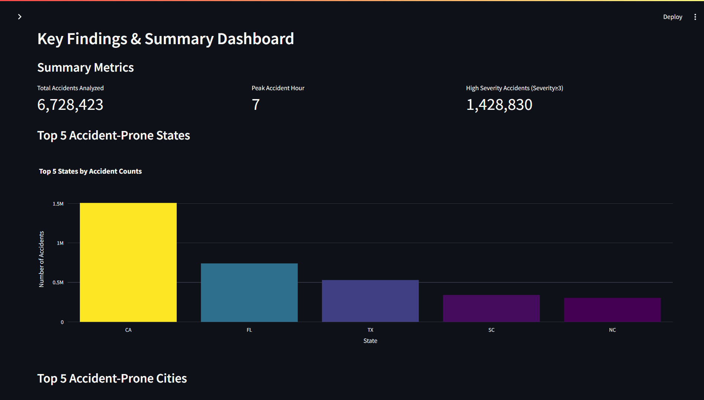
DASHBOARD 3
Findings :-
1. Large Dataset Coverage - Over 6.7 million U.S. accidents analyzed for nationwide insights.
2. Peak Accident Time - Most accidents happen around 7 AM during rush hours.
3. High-Risk States and Cities - California, Florida, and Texas with Houston, Miami and Los Angeles report the most accidents.
4. Road & Weather Impact - Clear and rainy weather, along with junctions and crossings, see more accidents.
Example Insight : Accident Frequency by Hour of Day

Slide 10
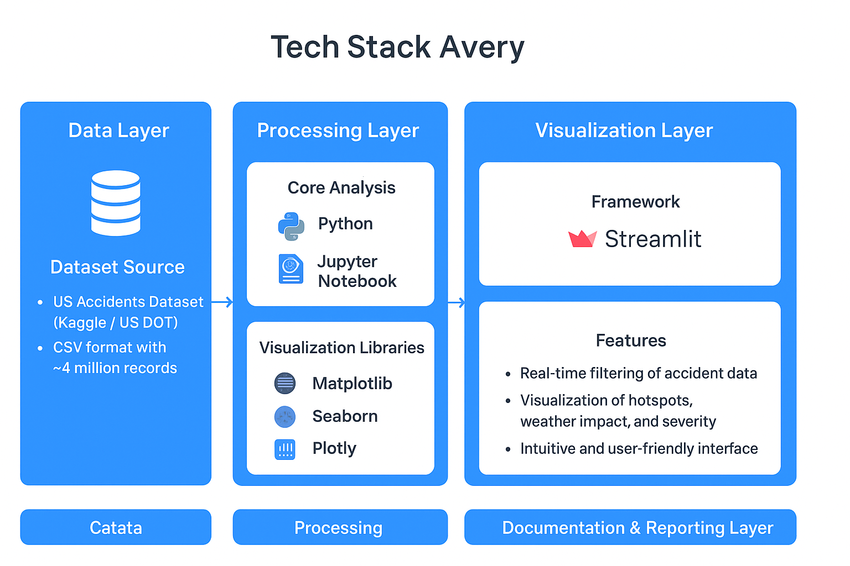
7
Dataset

Slide 11


FUTURE SCOPE
1. Real-Time Accident Monitoring - Integrating live traffic, weather, and visibility data can help in identifying accident-prone areas instantly.
2. Region-Specific Safety Insights - Expanding the model to analyze regional driving patterns can support targeted road-safety planning.
3. Predictive Severity Modeling - Enhancing the system to forecast accident severity based on evolving environmental and road conditions.
4. Public Awareness and Policy Support - Using insights to design awareness tools and assist policymakers helps in improving safety regulations.
CONCLUSION
This project analyzed large-scale U.S. accident data to uncover key factors influencing accident severity, such as weather, visibility, and time of occurrence. The developed interactive dashboard makes complex data easy to interpret, helping identify high-risk patterns and areas. Overall, the study highlights how data-driven insights can support smarter decisions and contribute to improving road safety.

Slide 12
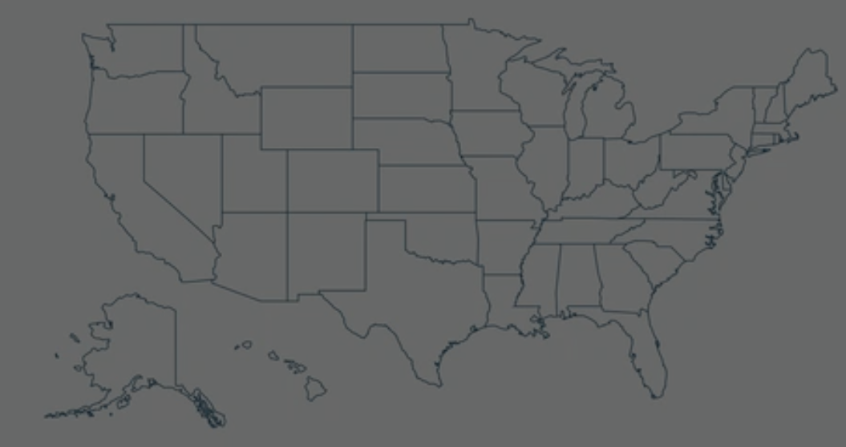
THANK YOU
max growth

